Slide 1
Forest Fire Simulation - Principles, Models and Application
L. Halada, J. Glasa, P. Weisenpacher
Institute of Informatics
Slovak Academy of Sciences

Slide 2
Motivation - Forest Fires in „Slovenský Raj“ National Park
1994-1998
Year | Number of Fires | Burnt area (ha) | Total damage (million Sk)
1994 | 5 | 1.59 | 60.0
1995 | 3 | 3.50 | 183.9
1996 | 5 | 2.37 | 33.6
1997 | - | - | -
1998 | 3 | 62.40 | 33.3
Total | 16 | 69.86 | 310.8

Slide 3
Scientific Goals
Further improvement of the computational model applied.
To test methods of data analysis to precise the input parameters.

Slide 4
Practical Goals
Creation of a decision support system for a protection of selected areas.
As a means provided to a training centre for practical implementation.
As a tool for universities, ecosystem institutions, insurance companies, etc.

Slide 5
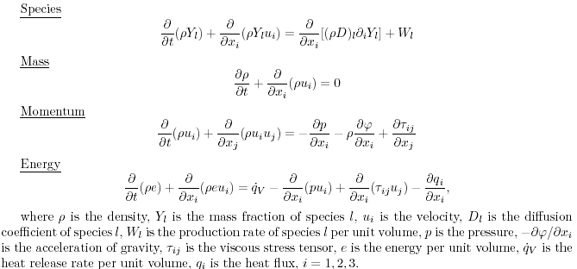
Basic Principles - Conservation Equations

Slide 6
Difficulties of the Problem
Complex structure of the wildland forest geometry
Complexity of chemical and physical dynamics of combustion
Turbulence
Meteorological conditions and their dependence on fire-induced air flows

Slide 7
Envelope Models – Huygens’ principle
A fire ignited at a point will expand under constant conditions and homogeneous fuel as an ellipse
Elliptic shape of fire depending on wind, slope and fuel
Secondary fires grow from the each point of the actual fire perimeter
Envelope that encompasses all small ellipses gives a fire perimeter in the next instant

Slide 8
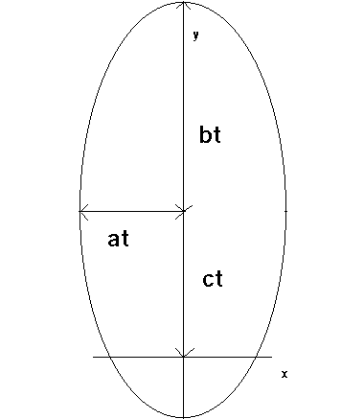
Principles of the Propagation in Envelope Model – Step I
Local fire:
x(ϕ,t) = a. t . cos(ϕ)
y(ϕ,t) = c. t +b. t . sin(ϕ)
0 ≤ ϕ ≤ 2π
b+c, b-c, a – forward, backward and lateral rate of fire spread

Slide 9
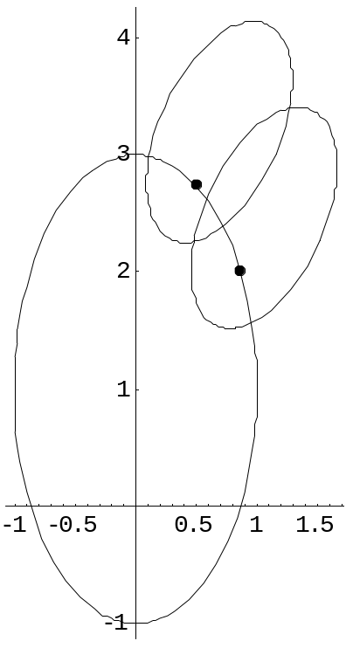
Principles of the Propagation in Envelope Model – Step II
Huygens’ principle:
Ellipses generated in points (x(i), y(i)), i = 1,2 .
New fire front is defined by the envelope of the ellipses generated at each point of the fire line.

Slide 10
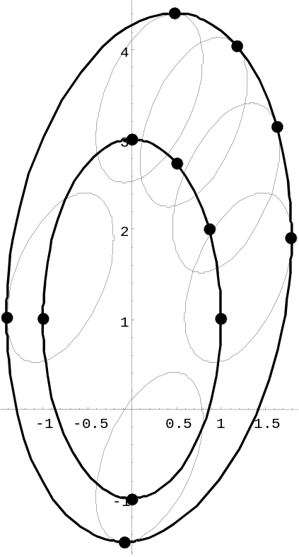
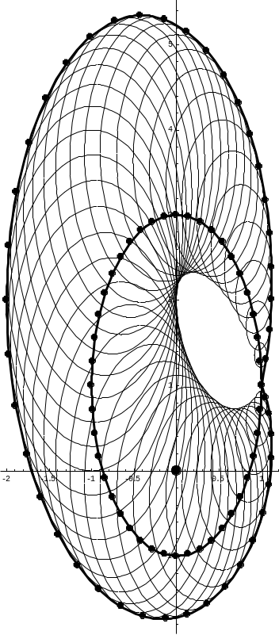
Huygens’ principle
Changed wind direction, constant fuel
Constant wind direction, variable fuel

Slide 11
Envelope Model - Practical Application
Correction to non-zero slope
Evaluation of the value ϕ – the angle of the resultant wind-slope vector (Rothermel 1972)
Length to breath (LB) and head to back (HB) ratio (Anderson 1983) of the ellipse

Slide 12
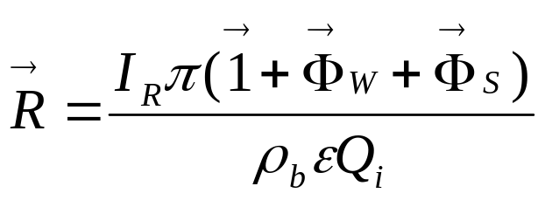
Envelope Model - Practical Application
Steady-state fire spread rate (Albini 1976, Rothermel 1972)
R - steady state spread rate I_{R} - reaction intensity,
π - propagating flux ratio ρ_{b} - bulk density
ε - effective heating number Q_{i} - heat of pre-ignition
Φ_{W} - wind coefficient Φ_{S} -slope coefficient

Slide 13
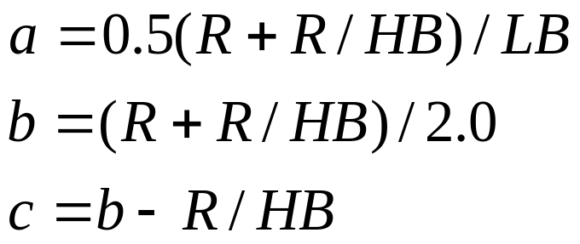
Envelope Model - Practical Application
Semi-axes of the ellipse

Slide 14
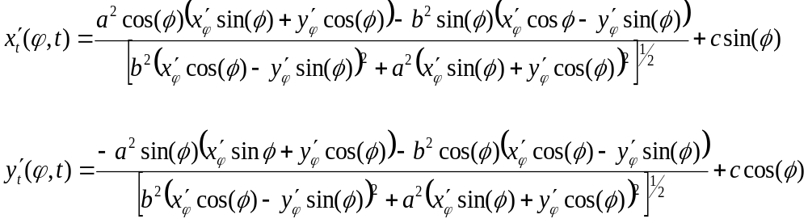
Envelope Model - Differential Equation for Fireline Propagation
Fireline is represented by a polygon consisting of series of 2D vertices

Slide 15
FARSITE (Fire Area Simulator) developed by M. A. Finney (1994)
program using envelope model for 2D numerical forest fire growth simulation in given area with given
  weather conditions
  fuel type
  topography

Slide 16
The Use of FARSITE
Simulation of past fires – reconstruction: A comparison of the simulated fires with the known fire growth pattern. Validation.
Simulation of active fires: Decision support and the computation-based control under given conditions.
Simulation of potential fires – prevention: Analyses of the possibility of their suppression under various conditions.

Slide 17
Additional models used in FARSITE
Crown fire model
Acceleration model
Spotting model
Fuel moisture model
Postfrontal combustion model

Slide 18
Input data
Topography data (GIS)
- elevation, slope, aspect
Fuel data (GIS)
- surface fuel model, canopy cover, stand height,
crown base height, crown bulk density
Meteorological data (Text)
- wind direction, wind speed, temperature,
relative humidity, precipitation

Slide 19
Surface Fuel Model Data
Fuel loading
- the mass of the fuel per unit area grouped by the particle size classes (1h, 10h, 100h dead fuel, live woody, live herbaceous)
Surface area to volume ratio of each size group
Fuel depth (m)
Moisture of extinction (%)
Heat content of the dead and live fuel (kJ.kg⁻¹ )

Slide 20
Output Data
Raster files, ARCVIEW Shapefiles, vector files (*.vct)
Graphs, tables, pictures

Slide 21
Forest Fire in the “Slovenský Raj” National Park (23.10.2000)
The burnt area 64 ha
6 volunteers lost their lives
Cost of the fire protection 5,8 mil. Sk
Damage 356 mil. Sk
----------------------
Topography: hills and valleys
Cover : conifers (spruce, fir) 80%
maple, beech 20%

Slide 22
Assumptions of our simulation
Real data for topography (elevation, aspect, slope) and canopy cover (TU Zvolen)
Original fuel model TER, elaborated by intensive terrain measurements (TU Zvolen)
Meteorological data for wind, temperature and humidity from meteorological stations in Poprad and Telgart (TU Zvolen)

Slide 23
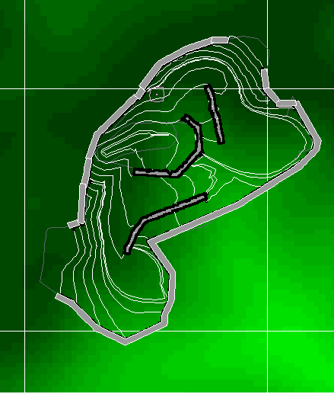
The Results of our Simulation

Slide 24
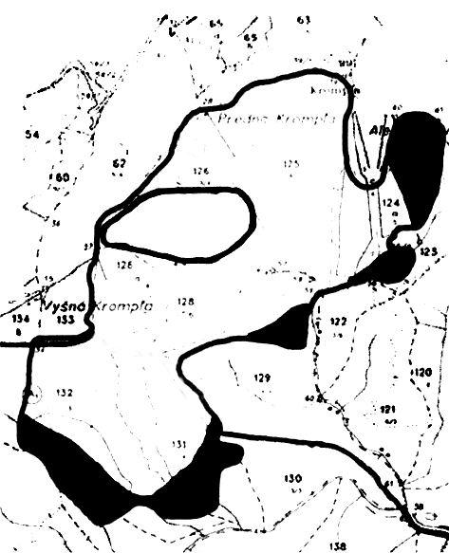
Real Fire Behavior

